Slide 1
Program
Overview
By: Vinci Wu

Slide 2
Fundamentals Introduction

Slide 3
Python
What is Python?
A popular programming language
  Scripting language: used for automating and performing functions.
  Interpreted language: no need for a compiler → allows it to run anywhere without setup
Simple and readable syntax
Versatile used for many applications:
  Ex:
    Web development
    Data analysis
    Artificial Intelligence
    Scientific research
Notes:
Official summary: What is Python? Executive Summary | Python.org

Slide 4
Functions
An encapsulated piece of code used to accomplish a specific task
Takes an input(s) and returns an output
  Does not necessarily need to take any input
  Does not necessarily need to return anything
Facilitates code reusability. Stops the need to write the same code.
Modularization and componentization.

Slide 5
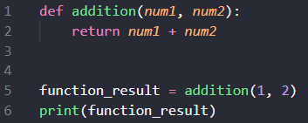
Keyword: def, denotes the following code as a Python function
Function name: addition, the name of our function which will be used to call it.
Function body: the code inside the function
  Return: the output of the function
Function call: invoke the function by providing necessary parameters
  function_result is a variable (mutable; holds a value)
  print is one of Python’s built-in functions to display its argument.

Slide 6
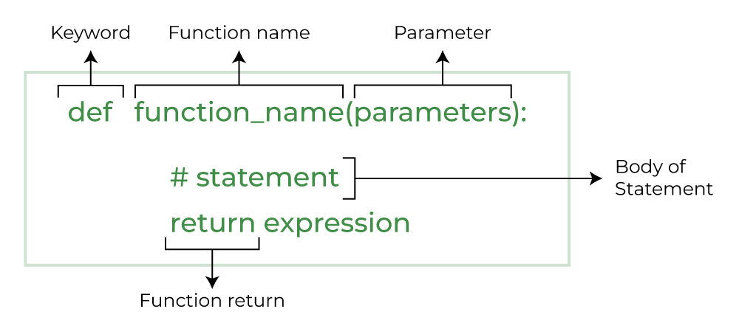
GeeksforGeeks. (n.d.). Python Functions. Retrieved July 29, 2023, from https://www.geeksforgeeks.org/python-functions/#

Slide 7
Data Structures
Containers to storage information.
Think of them as a way to organize data.
Many types of data structures from fixed length to variable.
Will focus on two used:
List
Dictionary

Slide 8
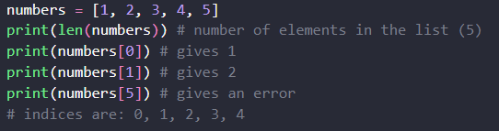
Python List
Widely used and versatile.
Items, called elements, are stored in order. Initialize it with square brackets ( [ ] ).
Mutable meaning can be changed. Items can be added and deleted.
Retrieve items in the list by using square brackets( [ ] )
  (Note: Python is 0-indexed meaning it starts at 0 rather than 1)
Example:

Slide 9

Python Dictionary
A data structure that holds key-value pairs which are values mapped to keys.
Known as a hashmap/map in other programming languages
Initialized with curly braces ( { } ).
To access a value mapped to a key use square brackets and the key associated ( [ ] )
Example:

Slide 10
Integrated Development Environment(IDE)
Software that allows programmers to create, edit, run, delete, and debug code.
For this program we will use Jupyter Notebook, a web-based interactive development environment for notebooks, code, and data.
Flexible, user-friendly, and used for data science, scientific computing, computational journalism, and machine learning.
IDE website: Project Jupyter | Home

Slide 11
Program Explanation

Slide 12
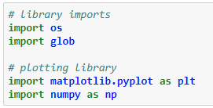
This code imports the libraries we will be using throughout this program.
os: allows the program to interact with the system’s operating system. We will be using it to read files.
glob: helps the program to grab files.
matplotlib.pyplot: used to create and visualize plots and data.
  Named it as plt for simpler calls
numpy: allows for more efficient management of data.
  Named it as np for simpler calls

Slide 13
Uses the glob and os libraries’ functions to extract all text file names from a given directory path.
  In this example “C:\\Users\\Vinci\\Desktop\\Ice Crystal Program\\07142023\\” is where all data text files are located.
  *.txt tells the function to fetch all files with .txt extension. (The * symbol means to select all)
Use Python’s built-in function len to get the number of txt_files gotten.
batch_sizes is the number of text files we want to read each time, in this case we want to only process 4 files at a time.
file_batches partitions each text file into a list of 4 stored in another list.
  The structure will be [ [ ], [ ], [ ] ], a 2D array/list

Slide 14
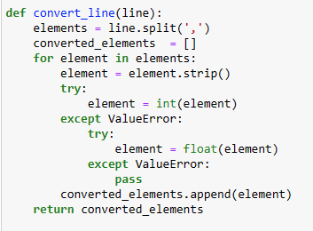
This is a function that takes in a line from a text file
A line is a string where each word is separated by a comma
  Example: “Object, Number, 38, 9.21”
It splits the string on the comma, resulting in a list of strings
  Example: [“Object”, “Number”, “38”, “9.21”]
It will then go through the list of strings and converts each item to its correct value.
  Integer, “38” → 38
  Float, “9.21” → 9.21
  String, remains a string, “Object” → “Object
returns a list of the line with each item properly converted to its proper type.

Slide 15
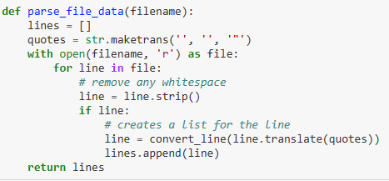
Parses the lines of a text file
maketrans is used, along with .translate to help remove quotations in the string.
Opens the text file and goes through it line by line.
Removes any spaces leading or ending.
Checks if the line is blank, if it isn’t, meaning line is not empty then we are able to use our previous function to get a list of each “word” in the line.

Slide 16
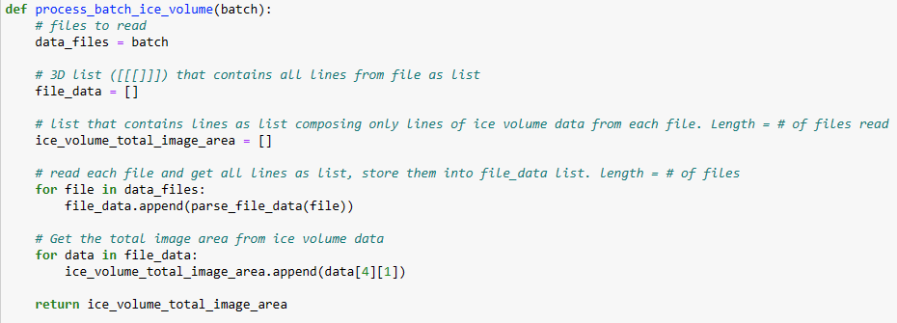
Function to read through the large data set from each 4 file batch and get only the total image area from the ice volume datas.
Returns a list of the total image area from each file.

Slide 17
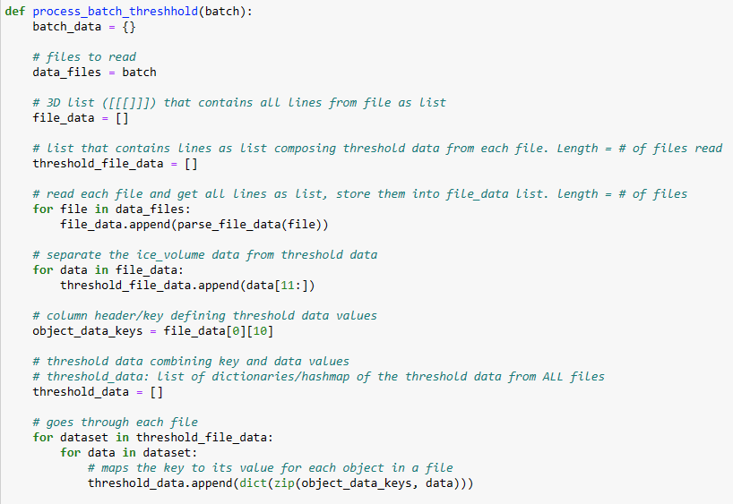
Part 1 of function process_batch_threshhold
Takes a list of filenames as input in parameter batch
Read each line from each of the 4 files and add them into the a single list.
For each file we then only keep the threshold data.
Get the column headers for the threshold data and store it in object_data_keys
We now have the threshold data and their column headers. Now we combine it to make it easier to manage and access the data.
  We go through the data set and map the respective header with its data (a dictionary which has key-value pairs)
Part 1

Slide 18
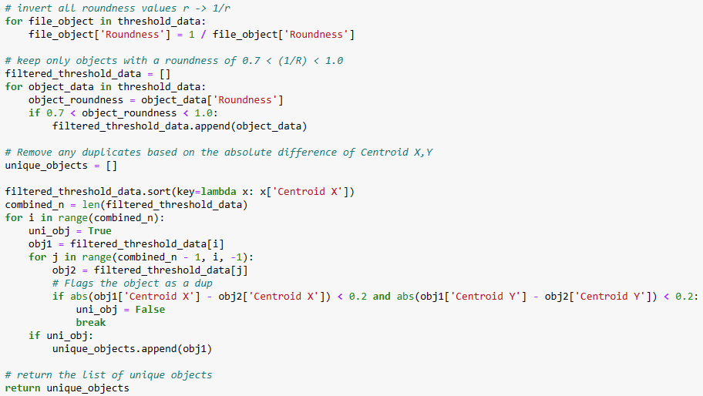
Part 2 of function process_batch_threshhold
We now filter the threshold data.
Inverse the roundness of each object. (This is made easier by us mapping the column header to its respective value.)
We go through the data and filter out objects based on roundness.
We then remove the objects that have an absolute difference of their X & Y < 0.2.
Return a list of all unique objects with the data associated with them (a list of dictionaries)

Slide 19
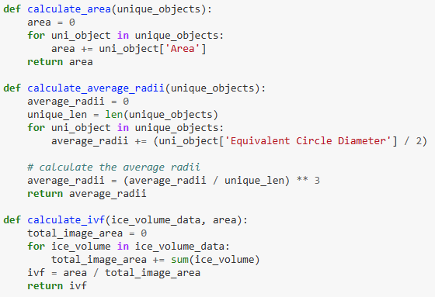
Area, Average Radii, & IVF helper functions
calculate_area: Gets the total area from all objects in the 4 file batch.
calculate_average_radii: Calculates the average radii for each object in the 4 file batch then cubes it.
calculate_ivf: Calculates the IVF using the total image area from the ice volume data and the total area for the 4 file batch

Slide 20
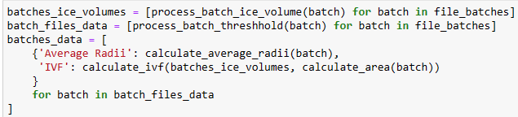
This is the “main” code.
Get all the ice volume total image areas for ALL files. A list of list ( [ [ ], [ ], [ ], … ]) with each inner list being length of 4 representing each batch of 4 files.
Get all the filtered and unique threshold data for ALL files. Same as above.
Create key-value mappings for each batch of 4 containing that batch’s average radii and IVF value.

Slide 21
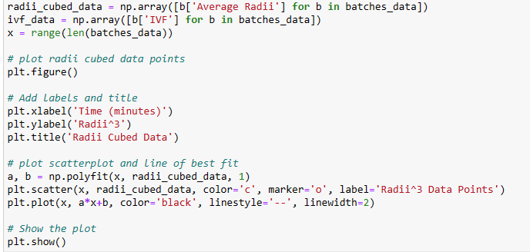
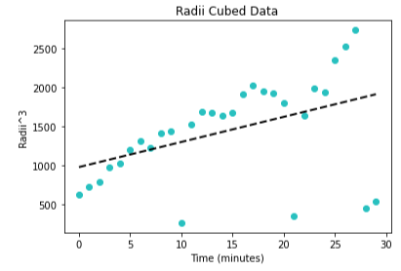
Creates a plot for our radii data
Converts out average radii data into a numpy array for faster computation (optional).
Create a new plot with matlibplot function figure()
Add x & y labels and title for the plot.
Create a line of best fit and scatter plot for the graph.
Show the graph with show() function.

Slide 22
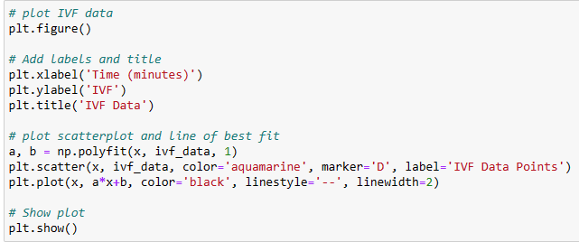
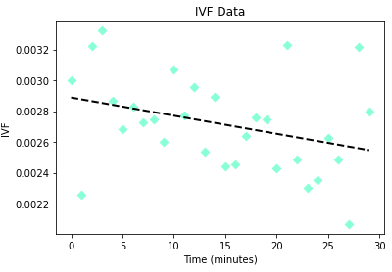
Creates a plot for our IVF
Converts out IVF into a numpy array for faster computation (optional).
Create a new plot with matlibplot function figure()
Add x & y labels and title for the plot.
Create a line of best fit and scatter plot for the graph.
Show the graph with show() function.

